Slide 1
Dr. Yifeng Zhu Electrical and Computer Engineering University of Maine
Embedded Systems with ARM Cortex-M Microcontrollers in Assembly Language and C
Chapter 22
USB: Universal Serial Bus
Spring 2020

Slide 2
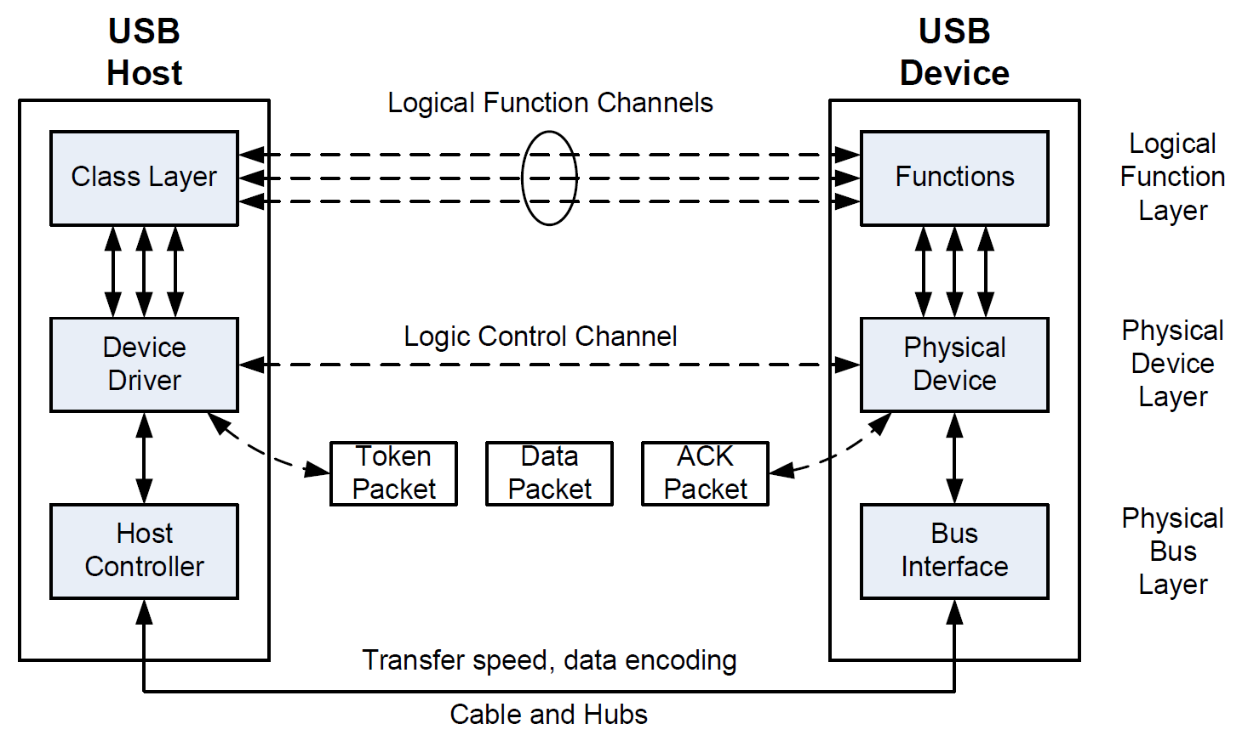
USB Layers

Slide 3
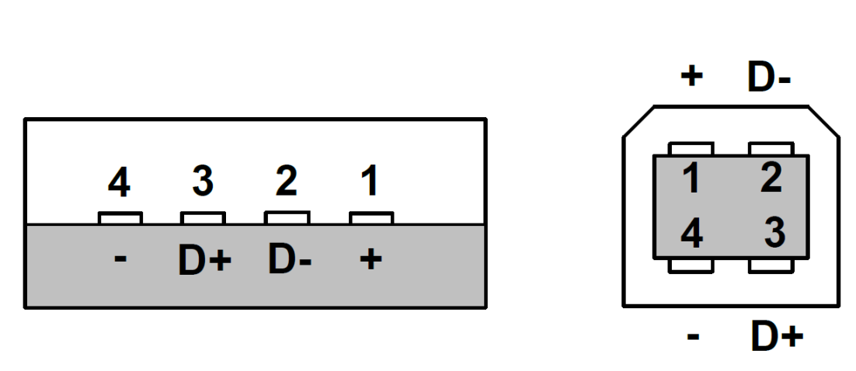
USB Connection
Standard A
Standard B
Four shielded wires: two for power (+5V, ground), two for data (D+, D-)
D+ and D- are twisted to cancel external electromagnetic interference
Image from wiki.com

Slide 4
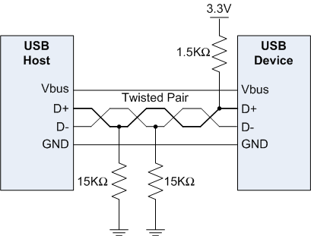
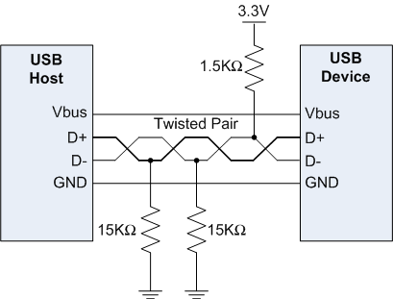
USB Speed Identification
USB supports four transmission speeds:
low speed (1.5 Mbit/s = 187 KB/s)
full speed (12 Mbit/s = 1.5 MB/s)
high speed (480 Mbit/s = 60 MB/s)
super speed (4.8 Gbit/s = 600 MB/s)
Full-speed mode (12 Mbits/s) identified by 1.5KΩ pull-up on D+
Low-speed mode (1.5Mbits/s) identified by 1.5KΩ pull-up on D-

Slide 5
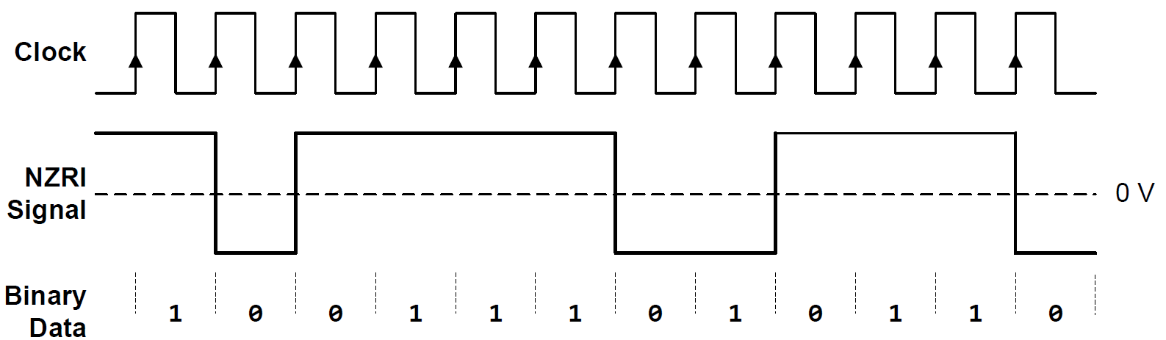
Non-Return-to-Zero Inverted (NRZI)
Logic 0: represented by a transition of the voltage level
Logic 1: represented by no transition

Slide 6
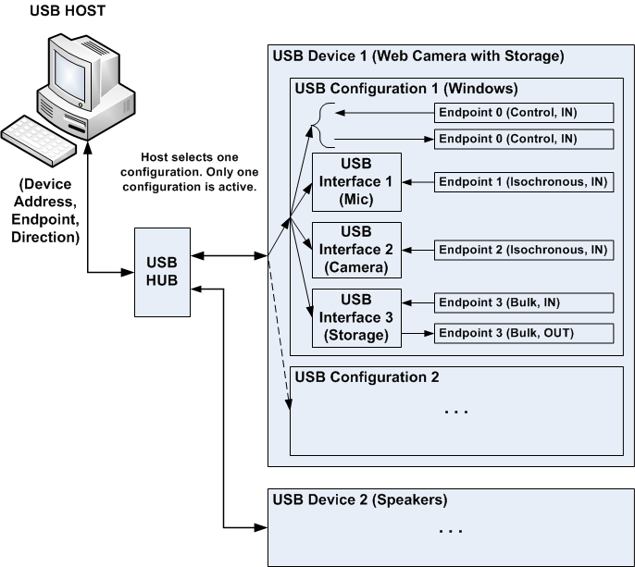
Interface

Slide 7
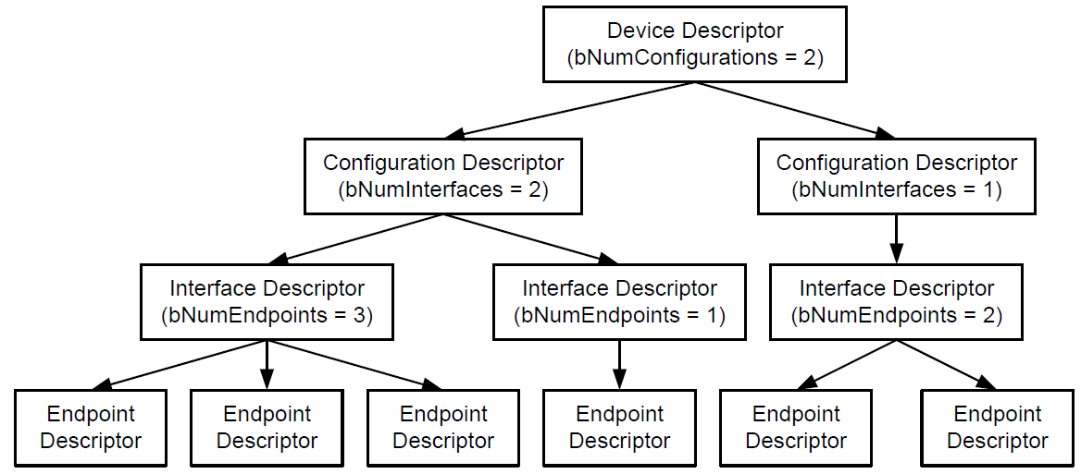
USB Descriptors

Slide 8
Field Name | Size | Offset
bLength | 1 | 0
bDescriptorType | 1 | 1
bcdUSB | 2 | 2
bDeviceClass | 1 | 4
bDeviceSubClass | 1 | 5
bDeviceProtocol | 1 | 6
bMaxPacketSize | 1 | 7
idVendor | 2 | 8
idProduct | 2 | 10
bcdDevice | 2 | 12
iManufacturer | 1 | 14
iProduct | 1 | 15
iSerialNumber | 1 | 16
bNumConfigurations | 1 | 17
Field Name | Size | Offset
bLength | 1 | 0
bDescriptorType | 1 | 1
wTotalLenght | 2 | 2
bNumInterfaces | 1 | 4
bConfigurationValue | 1 | 5
iConfiguration | 1 | 6
bmAttributes | 1 | 7
bMaxPower | 1 | 8
Configuration descriptor
Device descriptor
Field Name | Size | Offset
bLength | 1 | 0
bDescriptorType | 1 | 1
bInterfaceNumber | 1 | 2
bAlternateSetting | 1 | 3
bNumEndpoints | 1 | 4
bInterfaceClass | 1 | 5
bInterfaceSubClass | 1 | 6
bInterfaceProtocol | 1 | 7
iInterface | 1 | 8
Field Name | Size | Offset
bLength | 1 | 0
bDescriptorType | 1 | 1
bEndpointAddress | 1 | 2
bmAttributes | 1 | 3
wMaxPacketSize | 2 | 4
bInterval | 1 | 6
Endpoint descriptor
Interface descriptor

Slide 9
USB Enumeration
Detecting a device has been connected. When a USB device is plugged into a host, there is a change on the USB D+ or D- line since one of them is pulled up by the device.
Determining the USB speed. As introduced previously, pulling up D- via 1.5KΩ pull-up to 3V indicates a low-speed device. The same pull-up on D+ specifies a high-speed device.
Retrieving the device descriptor and determining what device is attached.
Retrieving all configuration descriptors. This process may take milliseconds to complete. The host selects one configuration.
Retrieving all interface descriptors.
Loading the corresponding device driver. This is typically handled by the operating systems on the host. The host typically uses idVendor and idProduct to match a driver.

Slide 10
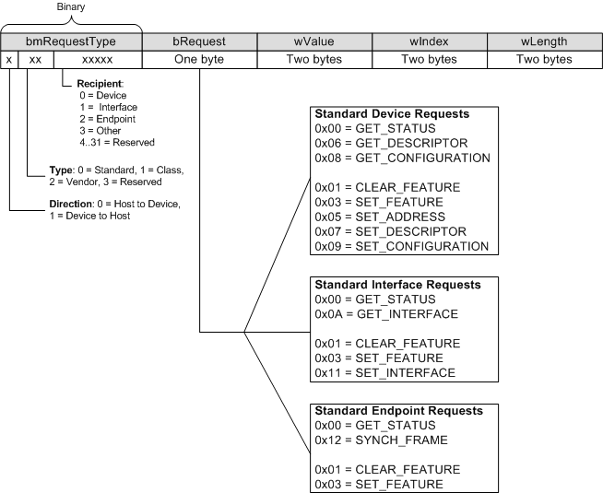
USB Enumeration
Format of Setup Request

Slide 11
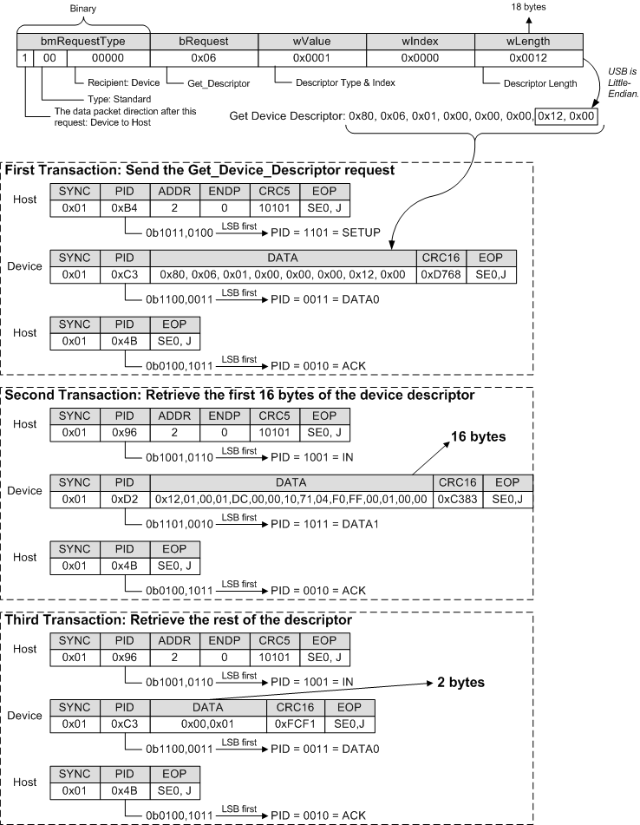

Slide 12
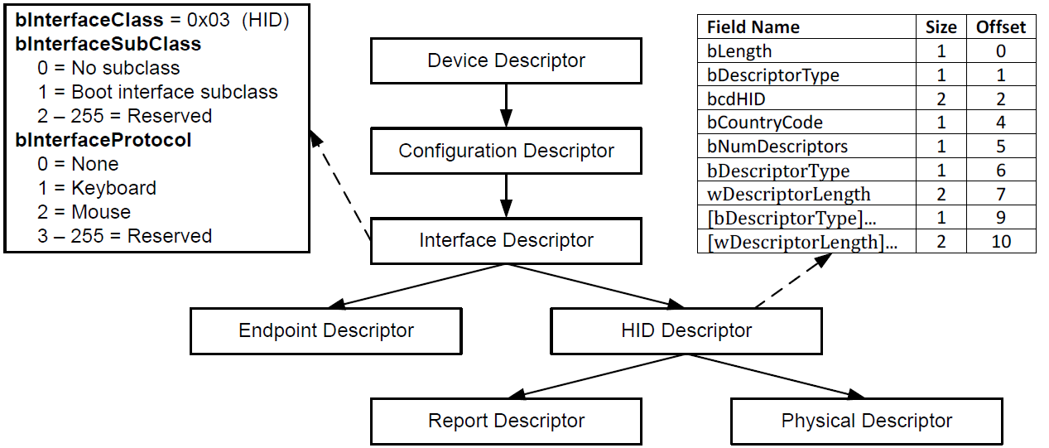
Human Interface Device

Slide 13
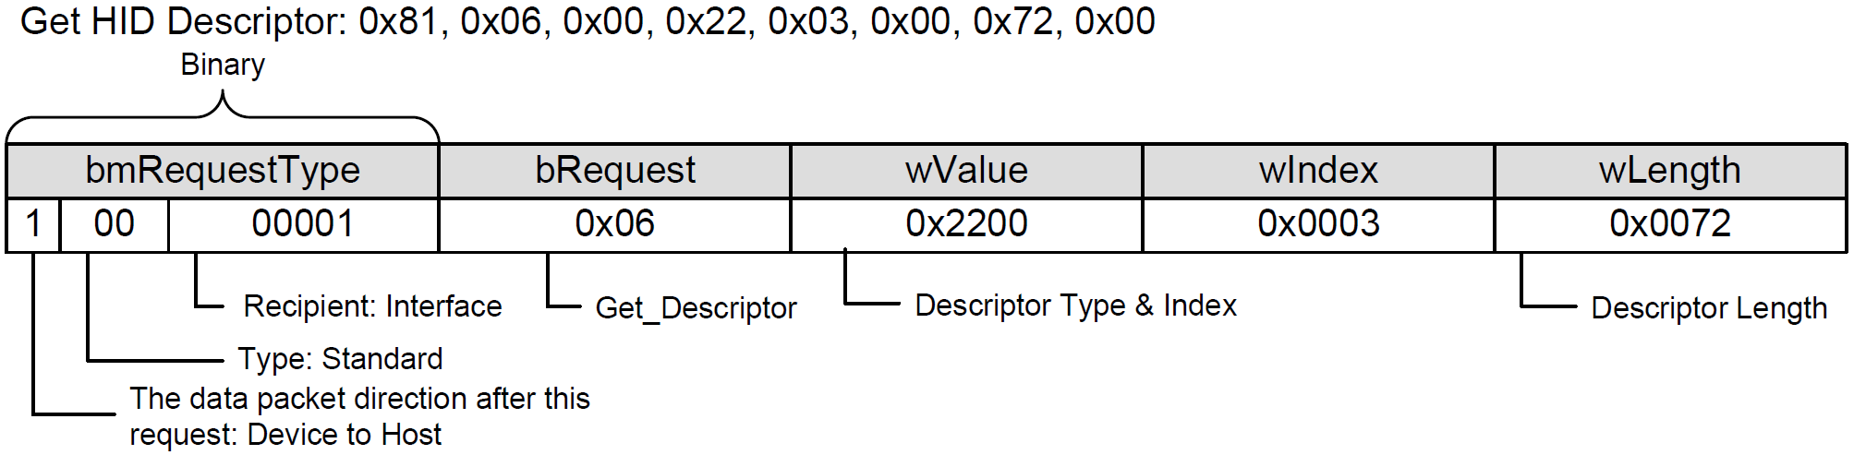
GET HID Descriptor

Slide 14
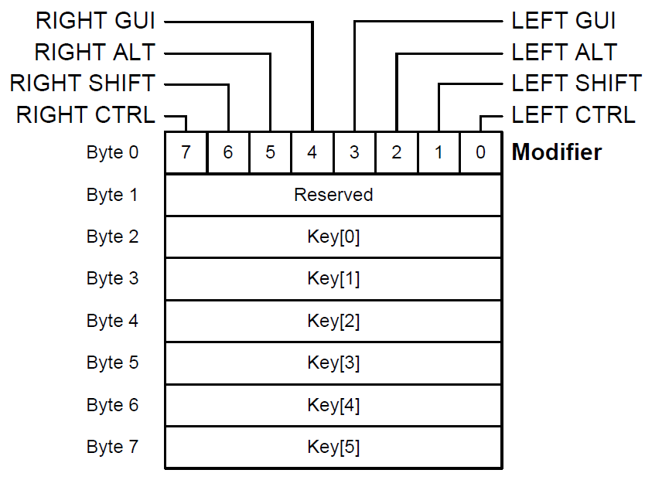
HID Report Format of Keyboard

Slide 15
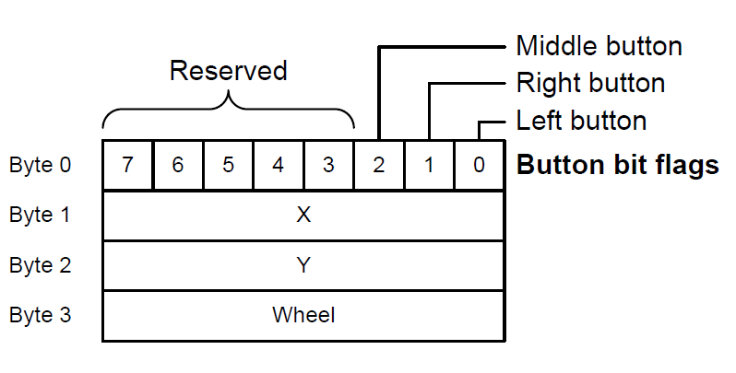
HID Report Format of Mouse

